Slide 1

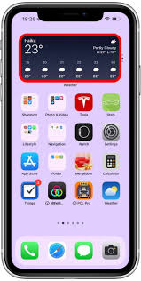

Slide 2
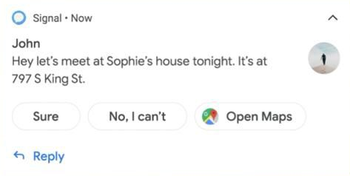
Notification
Current came!!!
Want to on the water motor
ON
OFF
ON
OFF

Slide 3

Notification
Current came!!!
Want to on the water motor
ON
OFF

Slide 4
Notification
Current came!!!
Want to on the water motor
ON
OFF
Motor Started

Slide 5
Notification
Current came!!!
ON
OFF
Motor Started

Slide 6
Notification
Current came!!!
ON
OFF
Motor stopped
Motor Started

Slide 7
Notification
Current Went Off!!!
ON
OFF
Motor stopped
Motor Started

